Slide 1

Heart Failure Prediction
Zach Dawson

Slide 2
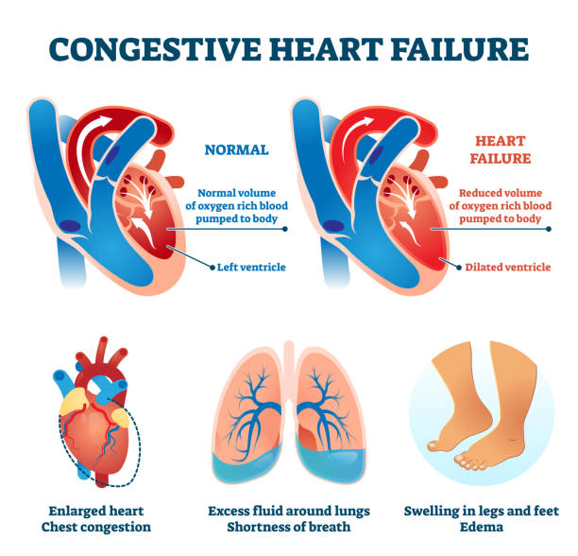
Project Overview
The purpose for this project, is to predict if a patient is at risk for heart failure. The data from this project is a collection of 5 independent datasets from different countries. Some of the risk factors for heart failure from this dataset includes Age, Sex, ChestPainType, etc.
What Cause Heart Failure
Heart failure or otherwise known as “congestive heart failure”, is a condition that that develops when the heart doesn’t pump enough blood for the body to function. Commonly, heart failure is caused by other medical conditions that damage the heart like coronary heart disease, heart inflammation, and high blood pressure.
Image Source

Slide 3
Heart Failure Dataset
This dataset was found on Kaggle (Heart Failure).
This dataset uses 11 features to help predict patients at risk.
Column | Description
Age | Age of the patient [years]
Sex | Sex of the patent [M: Male, F: Female]
ChestPainType | Chest pain type [TA: Typical Angina, ATA: Atypical Angina, NAP: Non-Anginal Pain, ASY: Asymptomatic
RestingBP | Resting Blood Pressure [mm Hg]
Cholesterol | Serum cholesterol [mm/d1]
FastingBS | Fasting blood sugar [1: if FastingBS > 120 mg/dl, 0: otherwise]
RestingECG | Resting electrocardiogram results [Normal: Normal, ST: having ST-T wave abnormality (T wave inversions and/or ST elevation or depression of > 0.05 mV), LVH: showing probable or definite left ventricular hypertrophy by Estes' criteria]
MaxHR | Maximum heart rate achieved [Numeric value between 60 and 202]
ExercisAngina | Exercise-induced angina [Y: Yes, N: No]
Oldpeak | Oldpeak = ST [Numeric value measured in depression]
ST_Slope | The slope of the peak exercise ST segment [Up: upsloping, Flat: flat, Down: downsloping]

Slide 4

Stake Holders
This is an analysis that could be used by a company to help predict if their patients are at risk of heart failure.
Doing this will not only provide proper care for patients but could also relieve insurance companies of covering patients' costs.
Image Source

Slide 5
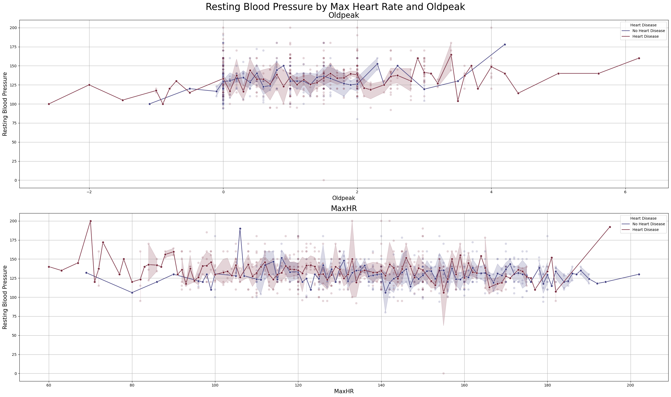
Key Findings
This graph shows trends if a patient with or without heart disease experience high or low resting blood pressure, max hear rate, and old peak.

Slide 6
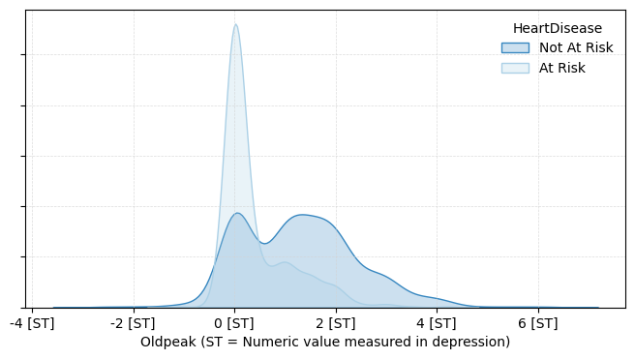
Key Findings
This model shows the density of patients that are at risk or not for heart failure by old peak.

Slide 7
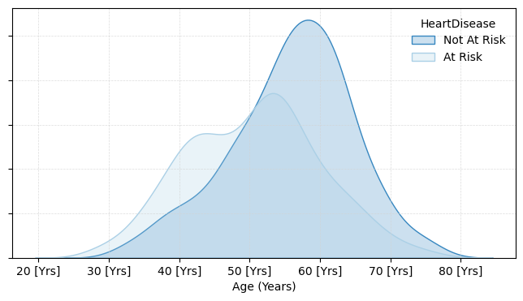
Key Findings
This visualization presents patients by Age and if at risk for heart failure.

Slide 8
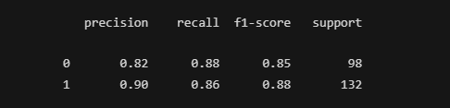
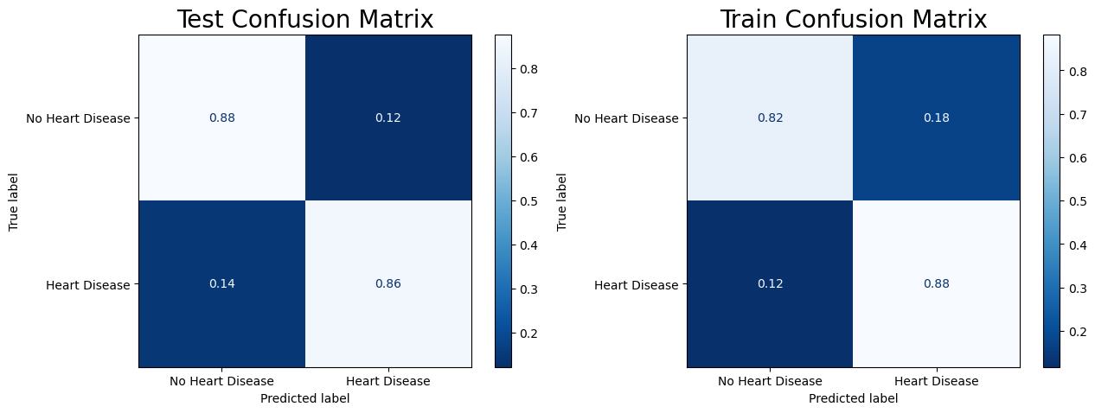
Model Evaluation
RandomForestClassifier
Minimizing the false negatives will prevent a patient at risk will get treatment.
The downside of this model is that the false positive is too high. This prevents a patient from receiving treatment.

Slide 9
Recommendations
Tuning this random forest classifier to decrease the false negatives would provide the resources needed for treating and preventing patients from illness.
Older patients, are commonly affected by heart failure typically cause by other illnesses related to heart disease.
Patients with a ST score of 0, have a higher rate of developing heart failure.

